Slide 1

Find Inverse of Matrix
Notes:
Outline:
Inverse
Invertibility
elementary row operation
in generatl

Slide 2

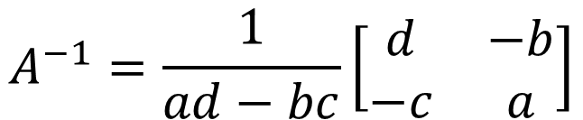
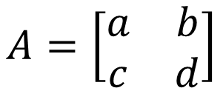
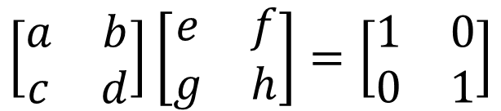
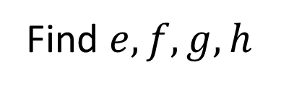
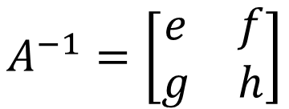
2 X 2 Matrix
$$A=\left[\begin{matrix}a & b \\ c & d\end{matrix}\right]$$
$$A^{−1}=\left[\begin{matrix}e & f \\ g & h\end{matrix}\right]$$
Find $e,f,g,h$
$$\left[\begin{matrix}a & b \\ c & d\end{matrix}\right]\left[\begin{matrix}e & f \\ g & h\end{matrix}\right]=\left[\begin{matrix}1 & 0 \\ 0 & 1\end{matrix}\right]$$
$$A^{−1}=\frac{1}{ad−bc}\left[\begin{matrix}d & −b \\ −c & a\end{matrix}\right]$$
If $ad−bc=0$, A is not invertible.

Slide 3




Algorithm for Matrix Inversion
Let A be an n x n matrix. A is invertible if and only if the reduced row echelon form of A is I_{n}
$$E_{k}⋯E_{2}E_{1}A=R$$
$$=I_{n}$$
$$A^{−1}$$
$$A^{−1}=E_{k}⋯E_{2}E_{1}$$

Slide 4




Algorithm for Matrix Inversion
Let A be an n x n matrix. Transform [ A I_{n} ] into its RREF [ R B ]
R is the RREF of A
B is a nxn matrix (not RREF)
If R = I_{n}, then A is invertible
B = A⁻¹
$$E_{k}⋯E_{2}E_{1}\left[\begin{matrix}A & I_{n}\end{matrix}\right]$$
$$=\left[\begin{matrix}R & E_{k}⋯E_{2}E_{1}\end{matrix}\right]$$
$$I_{n}$$
$$A^{−1}$$

Slide 5

Algorithm for Matrix Inversion
I_{n}
Invertible
RREF

Slide 6





Algorithm for Matrix Inversion
Let A be an n x n matrix. Transform [ A I_{n} ] into its RREF [ R B ]
R is the RREF of A
B is a nxn matrix (not RREF)
If R = I_{n}, then A is invertible
B = A⁻¹
To find A⁻¹C, transform [ A C ] into its RREF [ R C’ ]
C’ = A⁻¹C
$$A^{−1}C$$
$$E_{k}⋯E_{2}E_{1}\left[\begin{matrix}A & C\end{matrix}\right]$$
$$=\left[\begin{matrix}R & E_{k}⋯E_{2}E_{1}C\end{matrix}\right]$$
$$I_{n}$$
$$A^{−1}$$

